Slide 1
Project Title: Creating a SimObject , Adding Parameters to SimObjects and More Events, and Creating a Simple Cache Object and making enhancements

Slide 2
Project Description
Creating a SimObject - 1
Tutorial Goal: Learn to create a basic SimObject.
Enhancement: Add a counter attribute to track the number of times the SimObject is invoked, providing a simple way to observe its behavior.
Adding Parameters to SimObjects and More Events - 2
Tutorial Goal: Explore adding parameters and events to SimObjects.
Enhancement: Introduce a verbose boolean parameter to print debug information when enabled, showcasing conditional behavior.
Creating a Simple Cache Object - 3
Tutorial Goal: Build a basic cache object.
Enhancement: Add functionality to adjust cache associativity (e.g., from direct-mapped to 2-way associative), allowing users to see the impact of cache configurations.

Slide 3
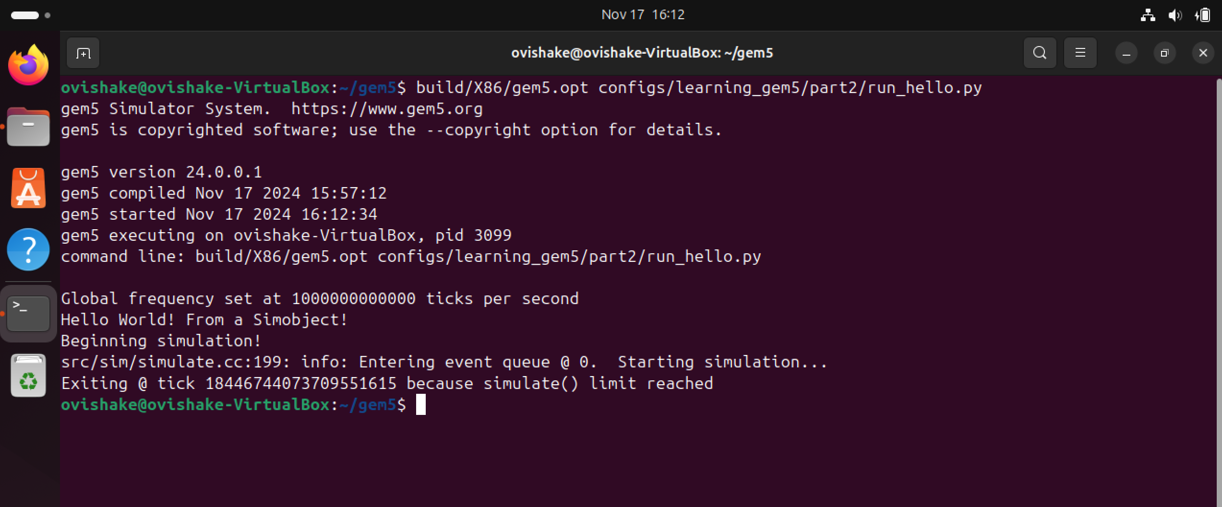
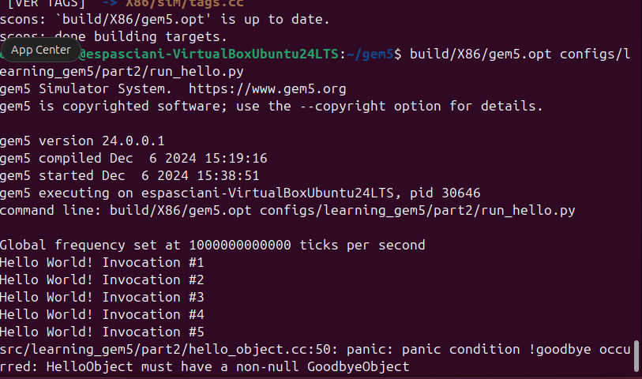
Result and Deliverable
Adding a SimObject Tutorial 1 – Completed
https://www.gem5.org/documentation/learning_gem5/part2/helloobject/
Original Output:
Enhanced Output:
Enhancement: Added new parameters to create multiple simple objects in one runtime, and creating a count to keep track of how many "Hello World!" Objects are created during the run.

Slide 4
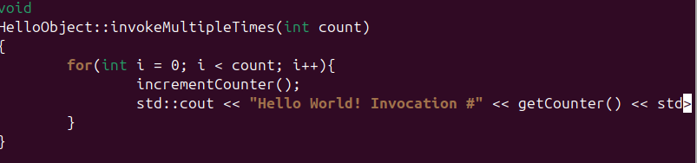
Result and Deliverable cont.
Learned how to add new parameters to SimObjects which have many real world use-cases
Parameter such as invocation count is helpful during simulations, such as those of processors.
More Object invocation can reflect heavy usage of hardware components or software functions. Having a count is a good for debugging and system wellness checks.
In case of bottlenecking of failure during a large simulation, an invocation count can show where or when such occurs.
Added Functions to keep track of multiple object invocations:

Slide 5
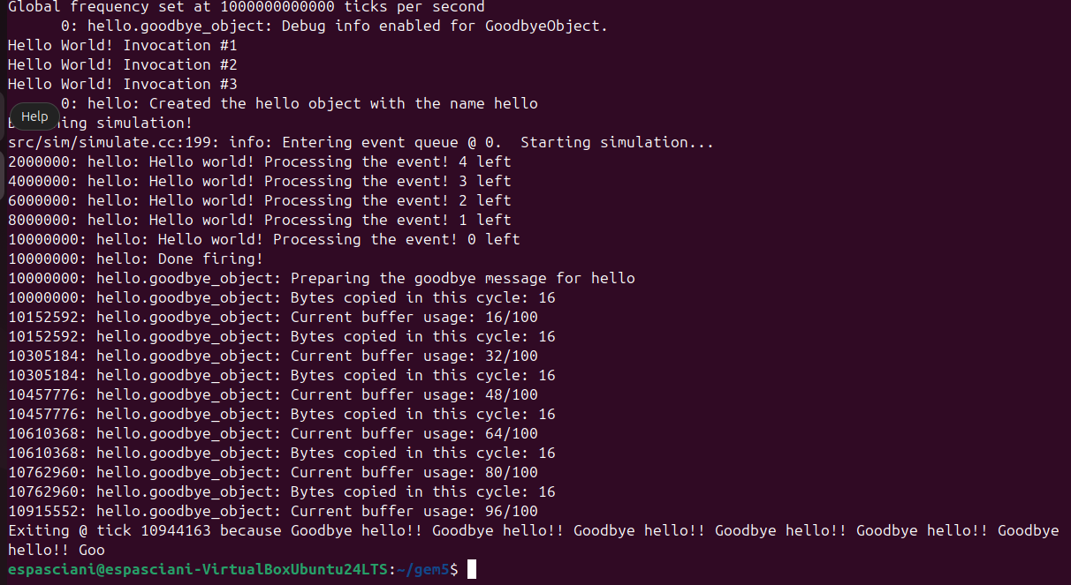
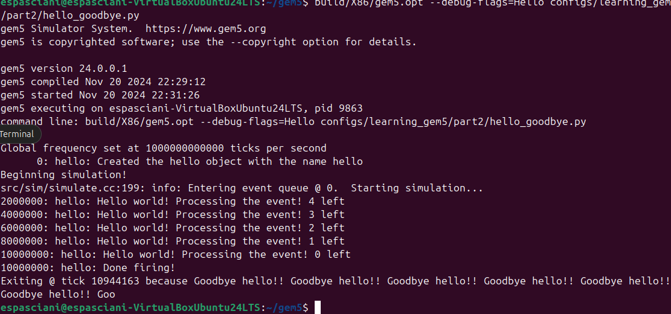
Result and Deliverable cont.
Adding Parameters to Sim Projects and More events - Completed
https://www.gem5.org/documentation/learning_gem5/part2/parameters/
Enhanced Output:
Original Output:
Enhancement: Added new parameters to debug flag 'hello' to output number of bytes copied in each cycle as well as the current buffer usage after each cycle.

Slide 6



Result and Deliverable cont.
Learned about customizable debug output to diagnose specific issues.
Learned how to output specific information during debug to prevent cluttering or reliance on pre-built debug systems.
Can be scaled with larger simulations utilizing the same debug system.
Debug is built with a simple bool to enable or disable the debug output.
DebugInfo displayed based on debugInfo bool being True.

Slide 7
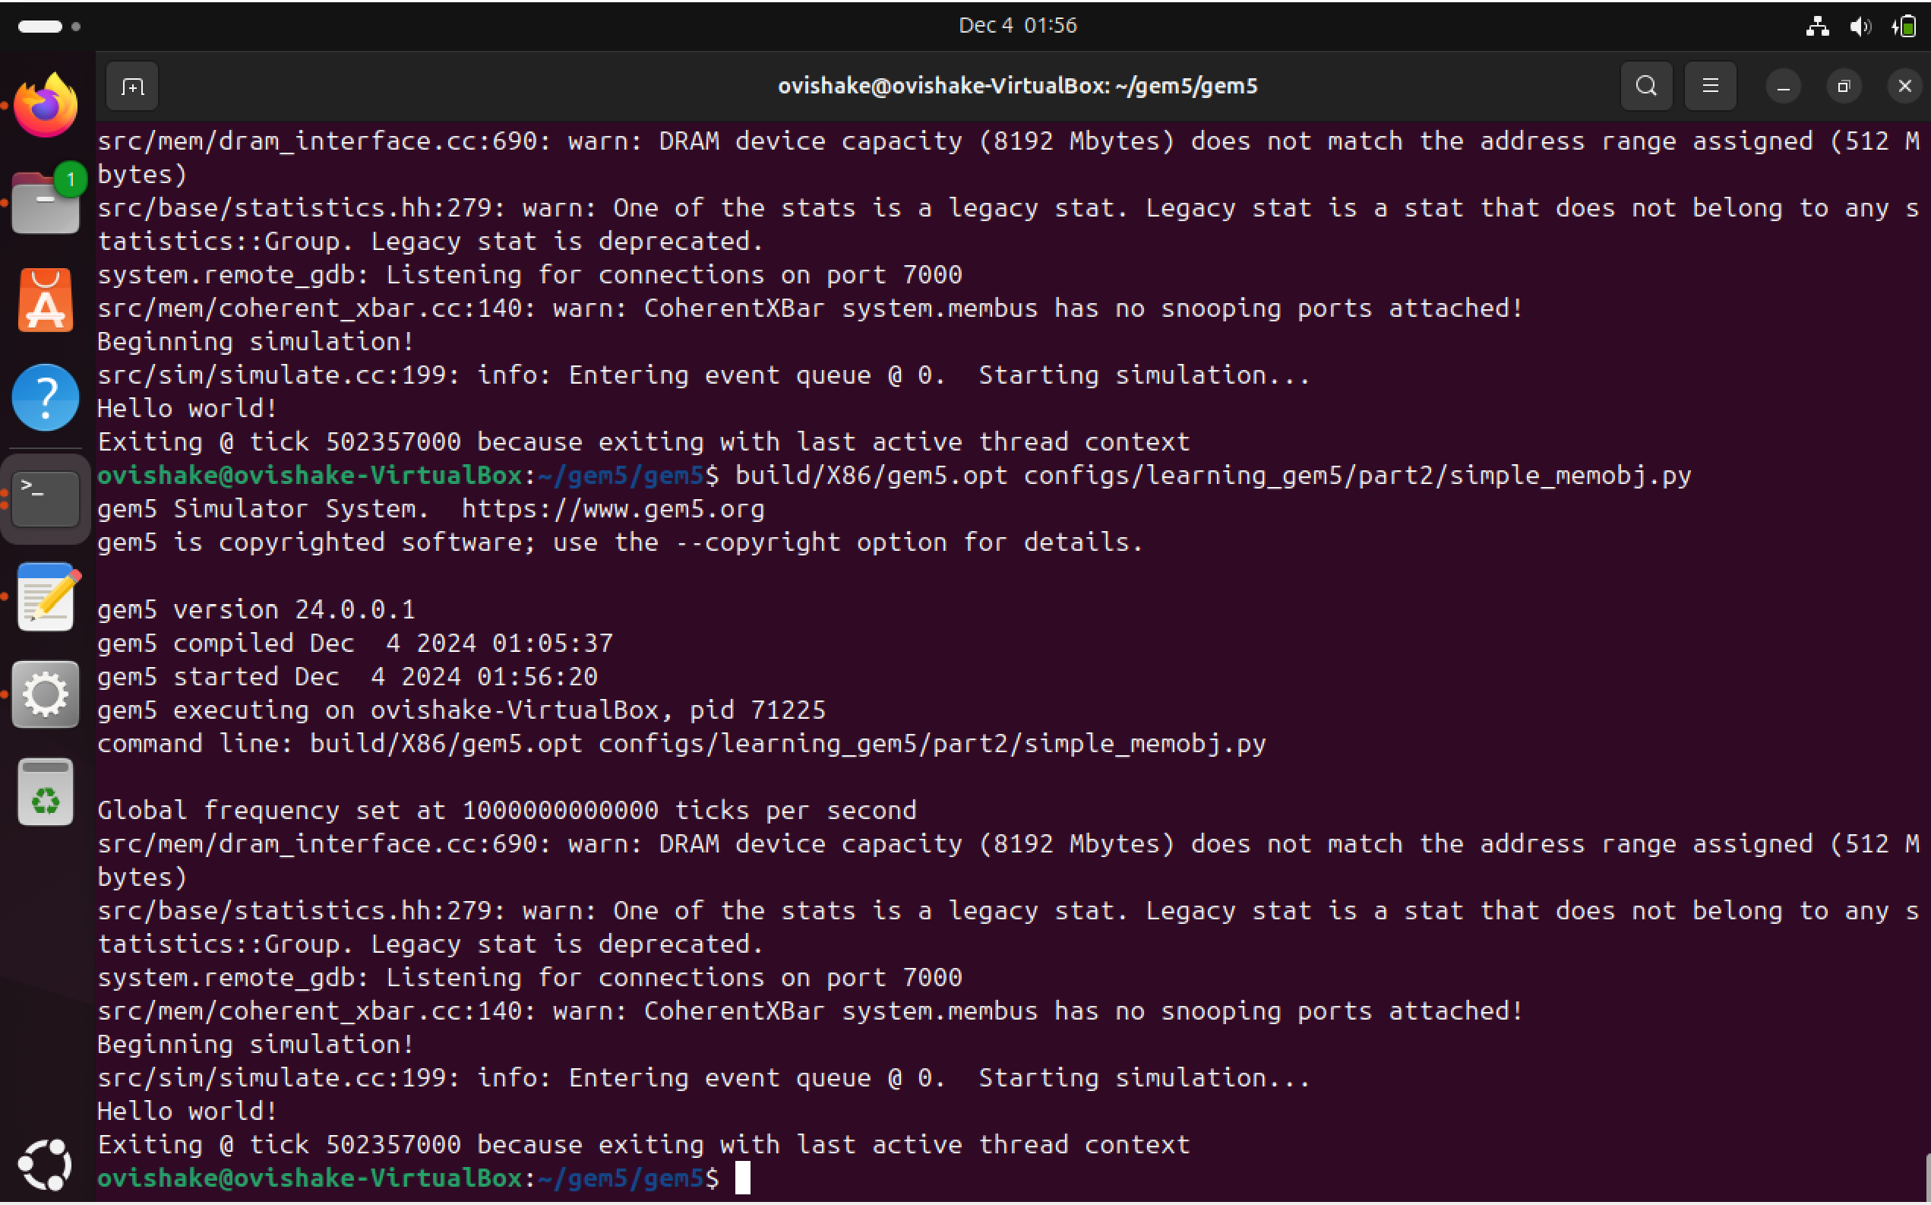
Result and Deliverable cont.
Creating a Simple Cache Object - - Completed
https://www.gem5.org/documentation/learning_gem5/part2/simplecache/

Slide 8
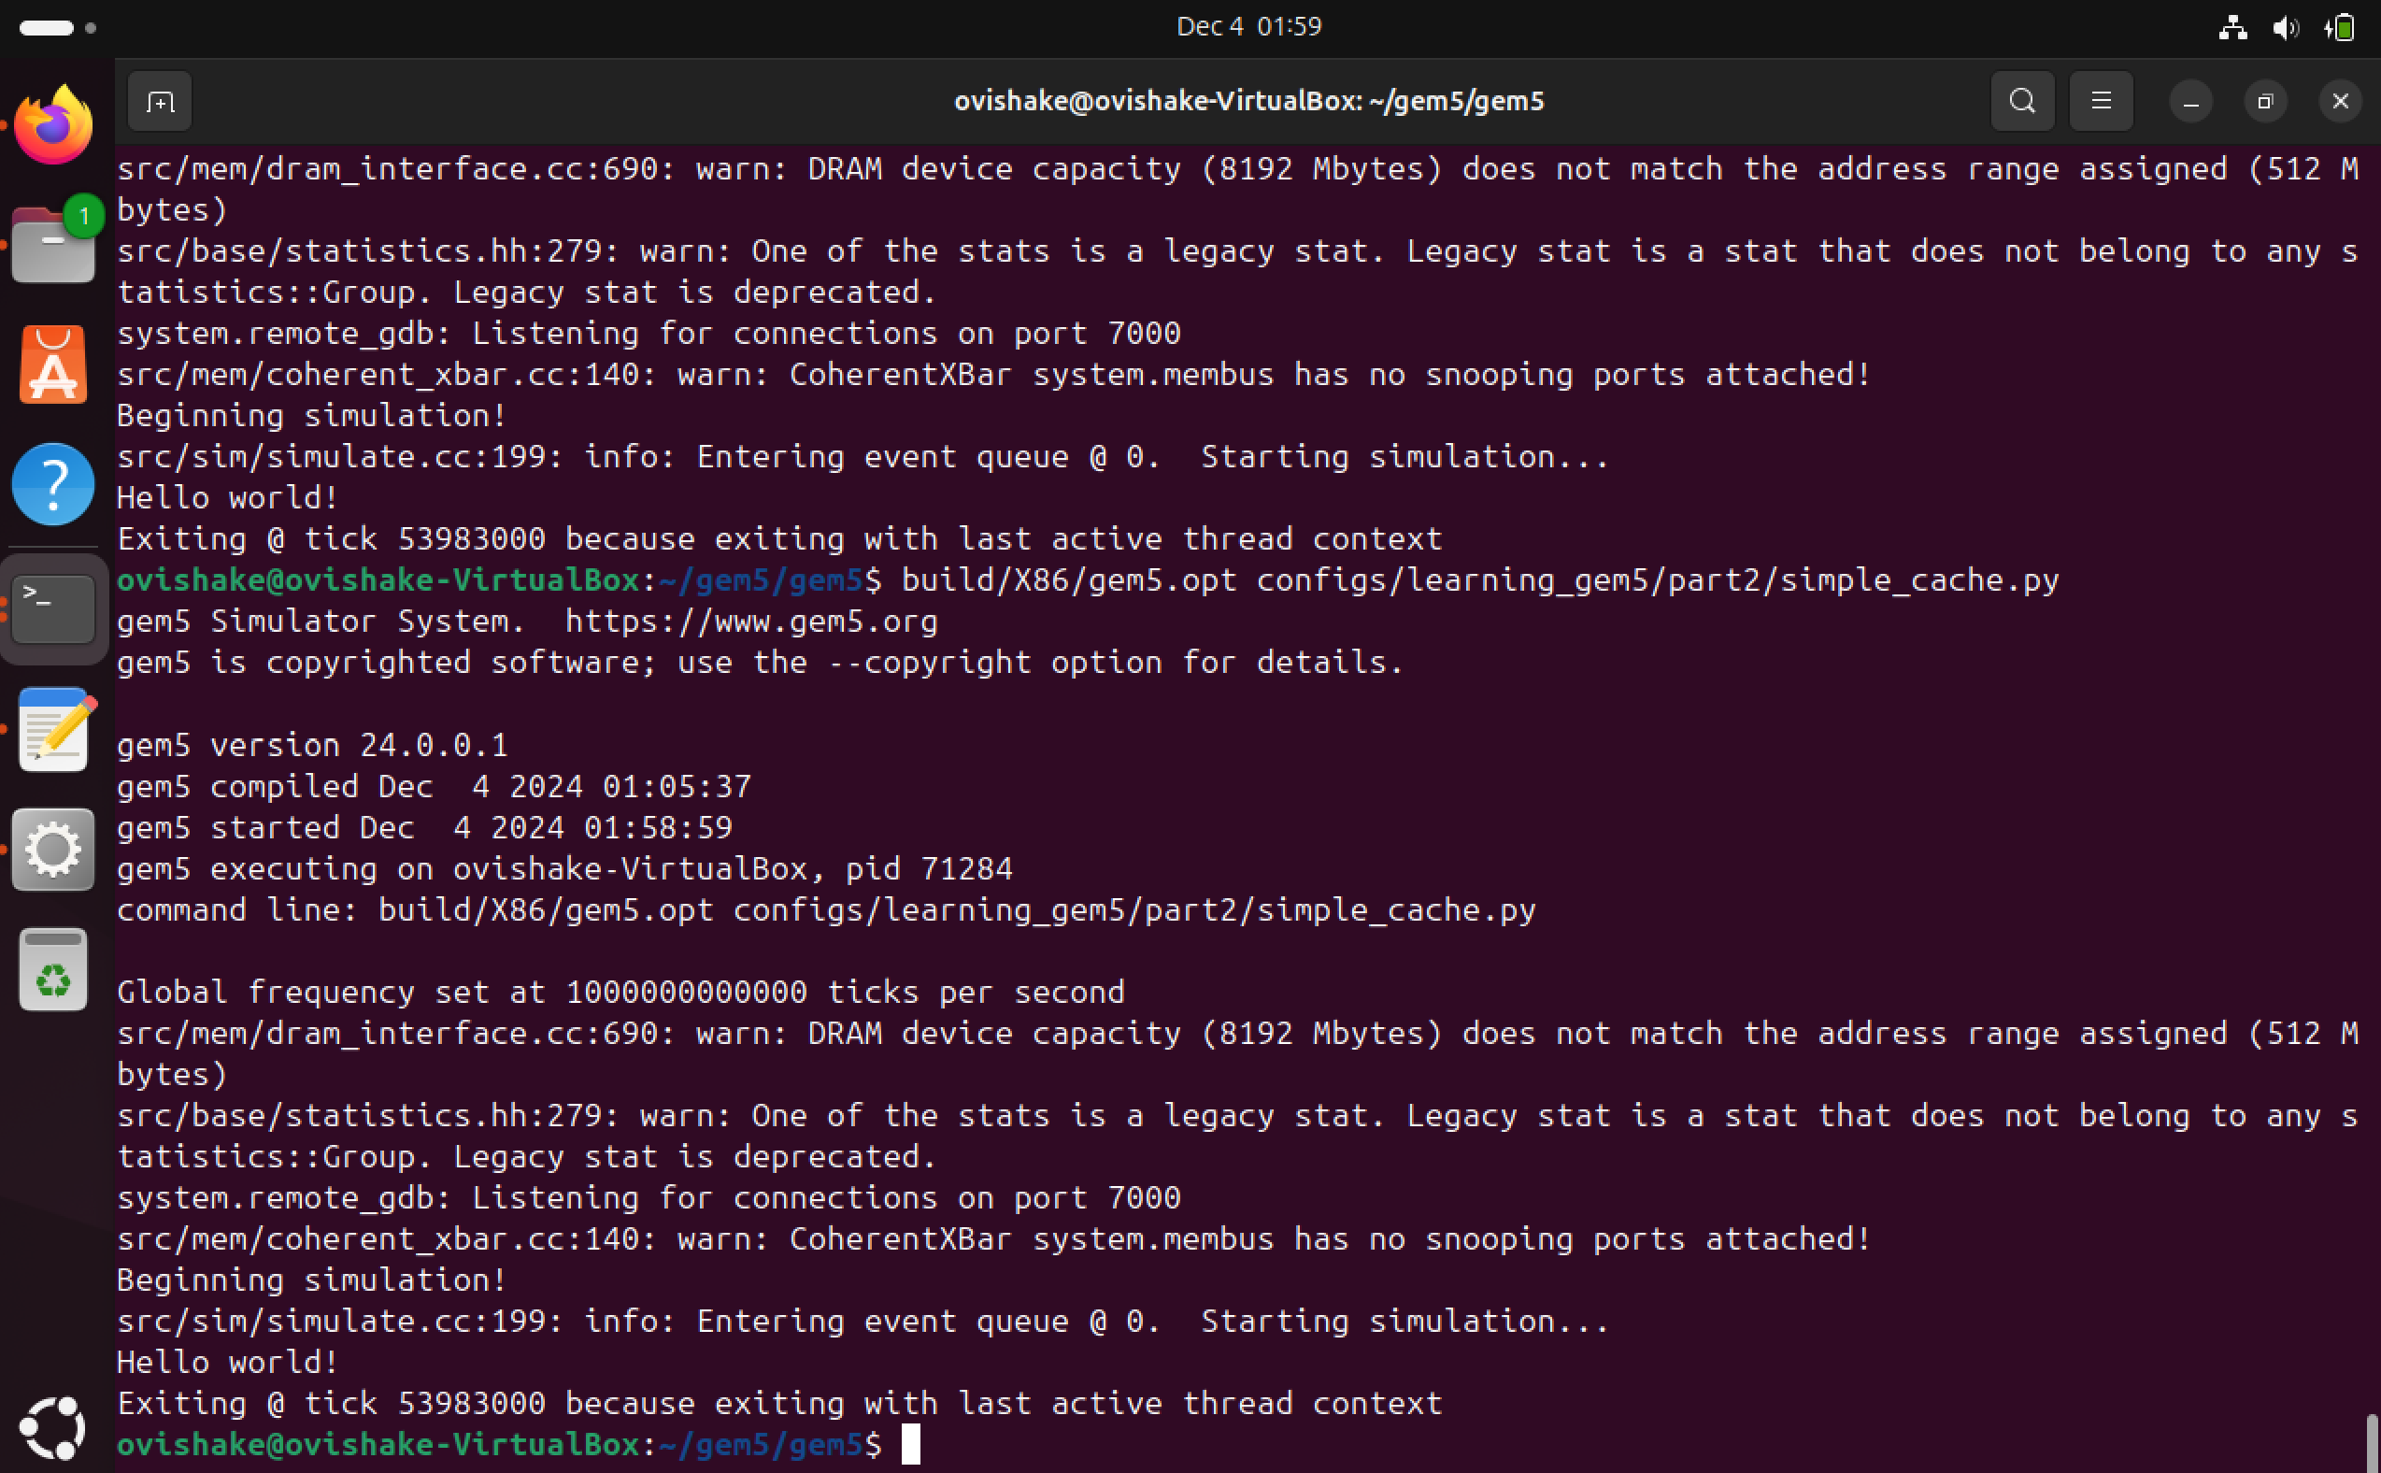
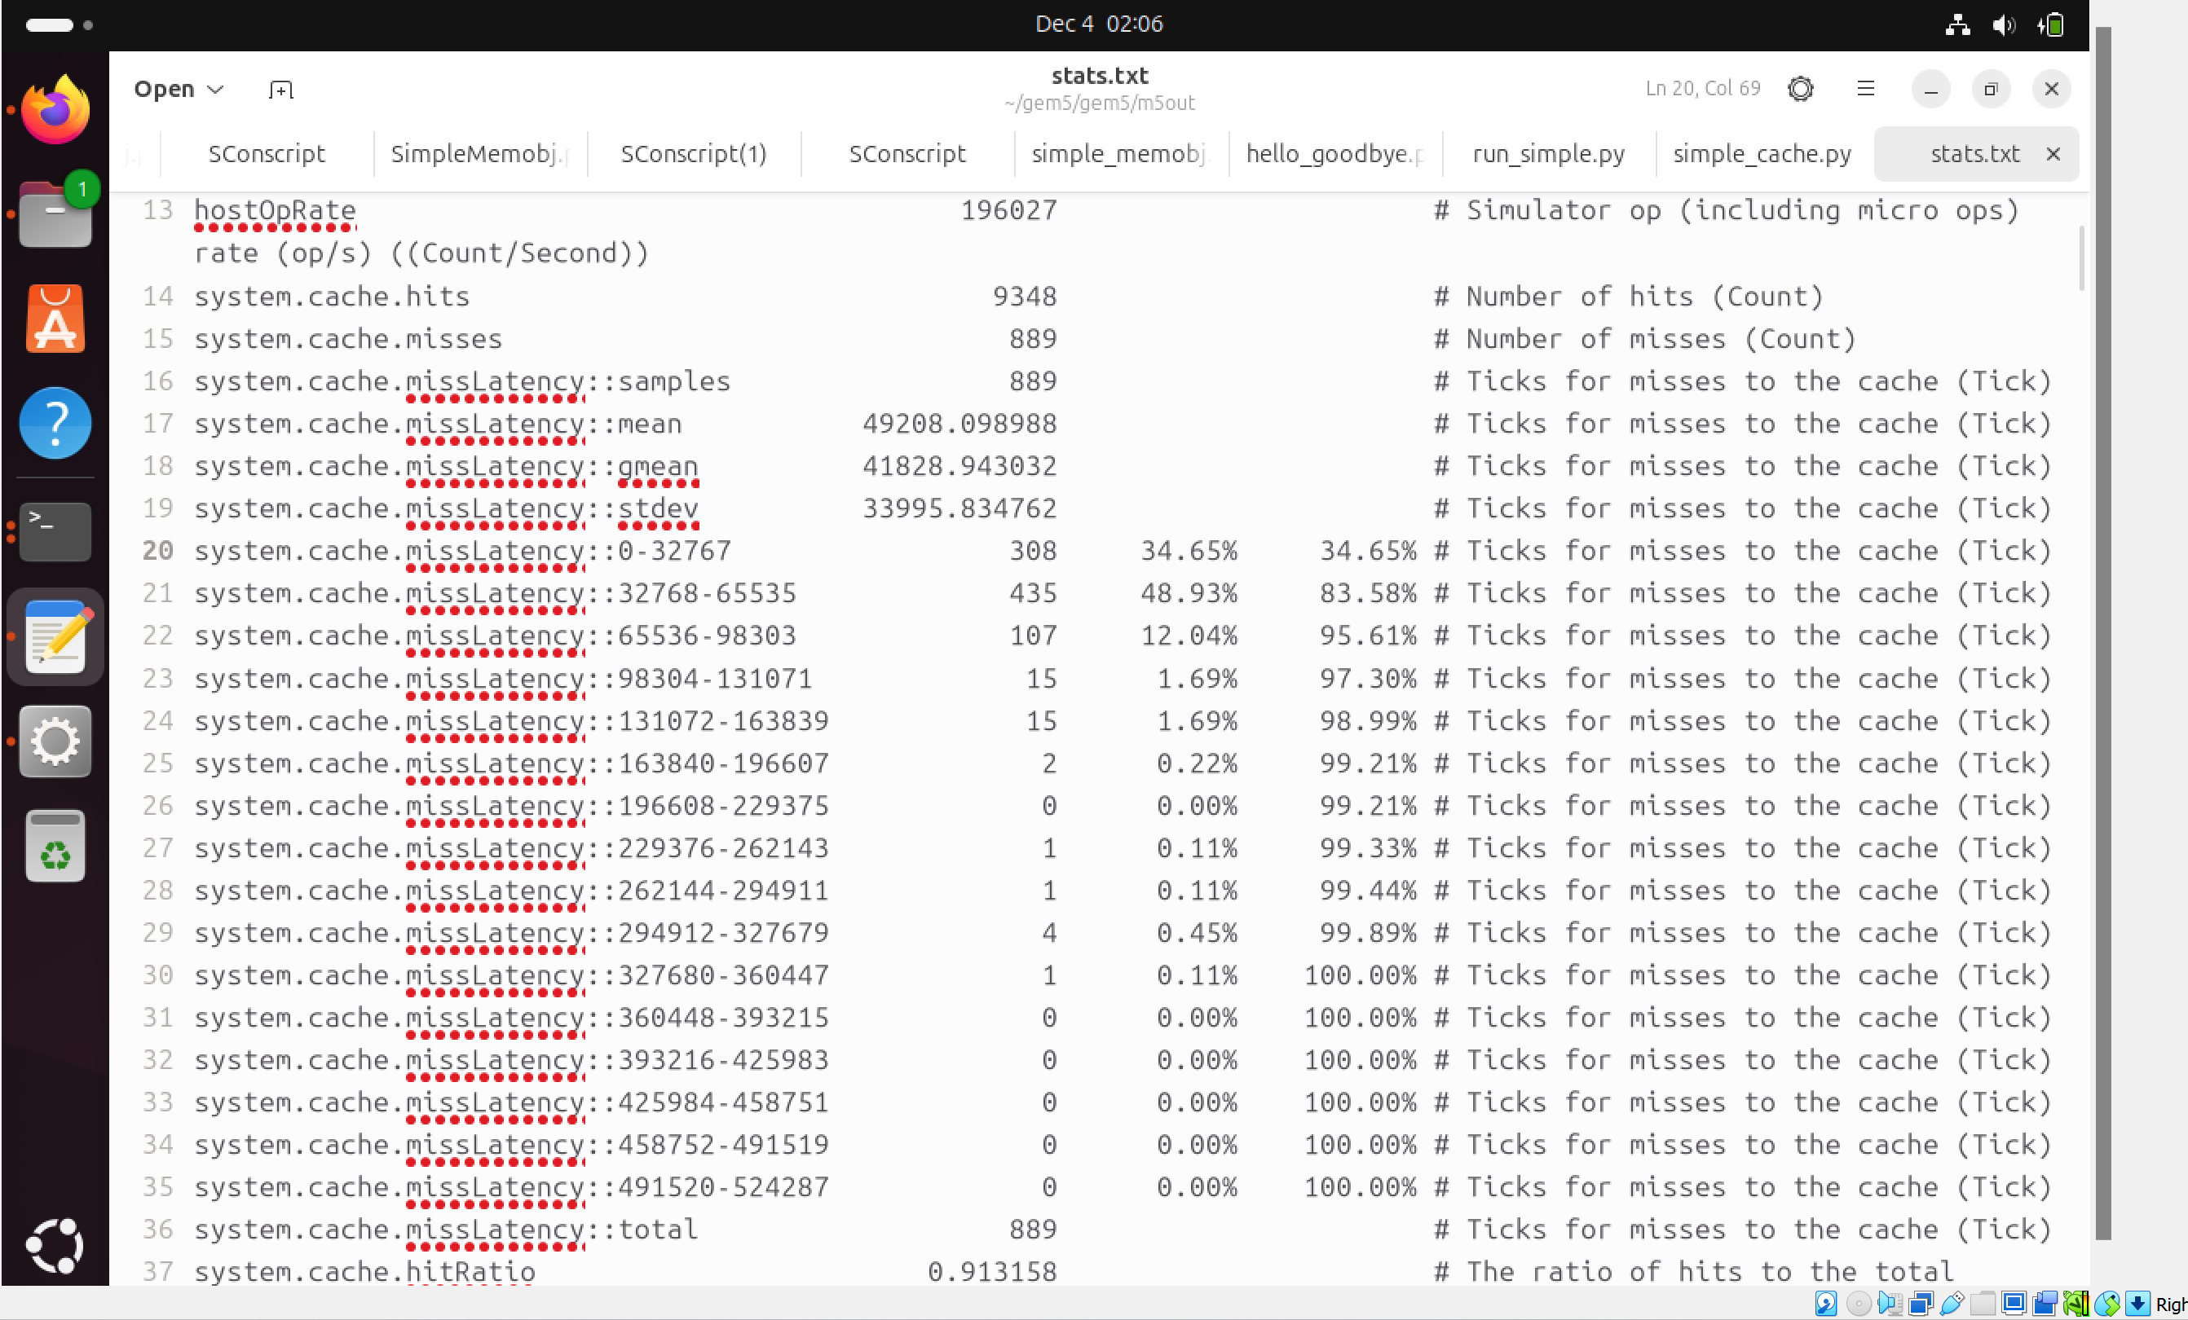
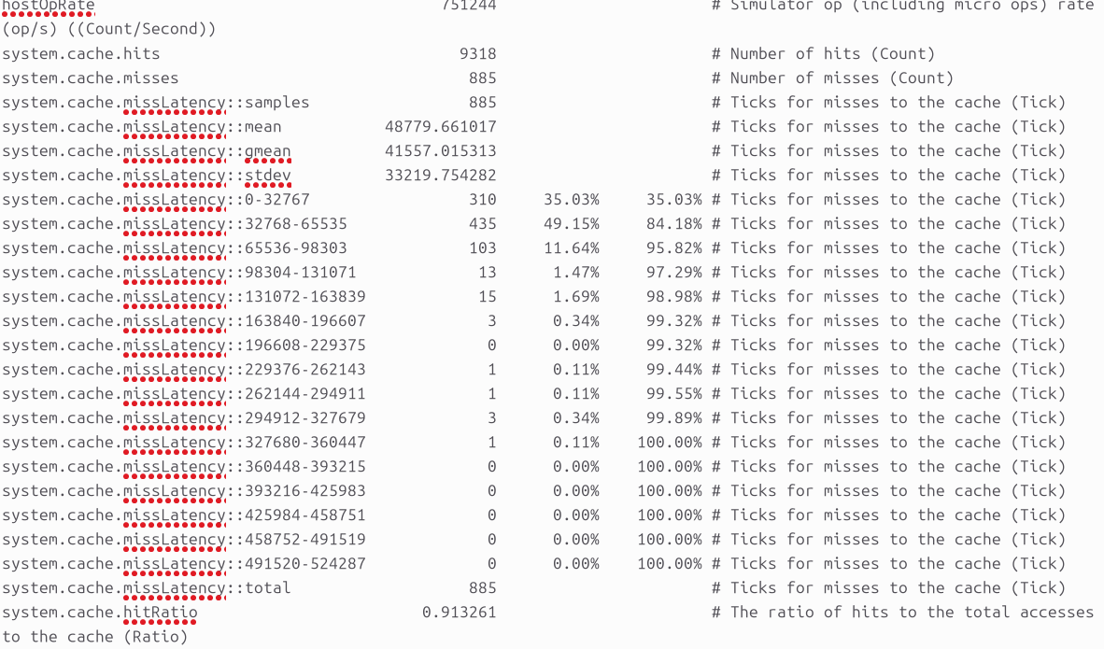
Result and Deliverable cont.
Testing the Cache of 1kB size
Direct-Mapped
2 Way Set Associative
Hit Ratio changes from 0.913158 to 0.913261

Slide 9
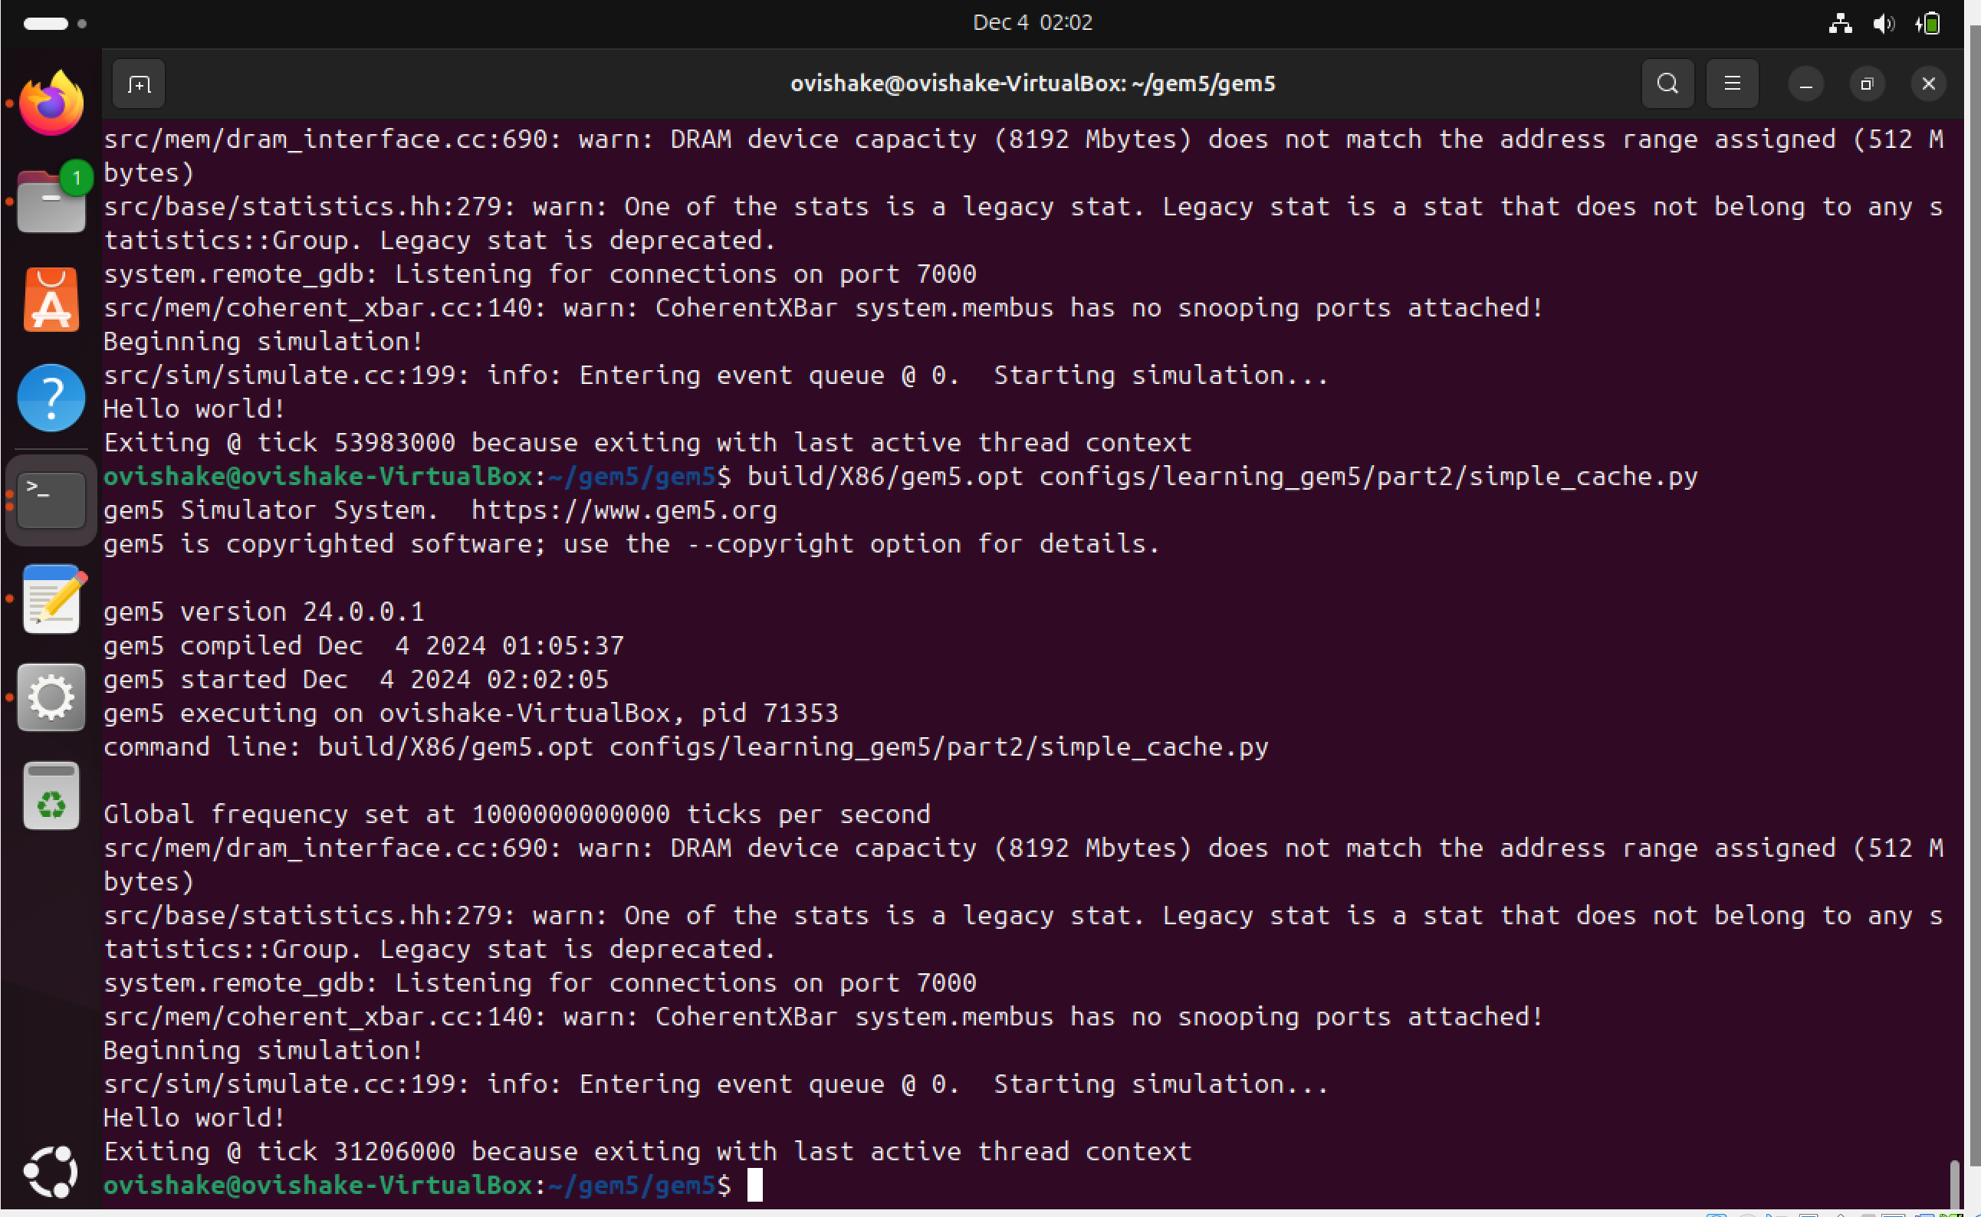
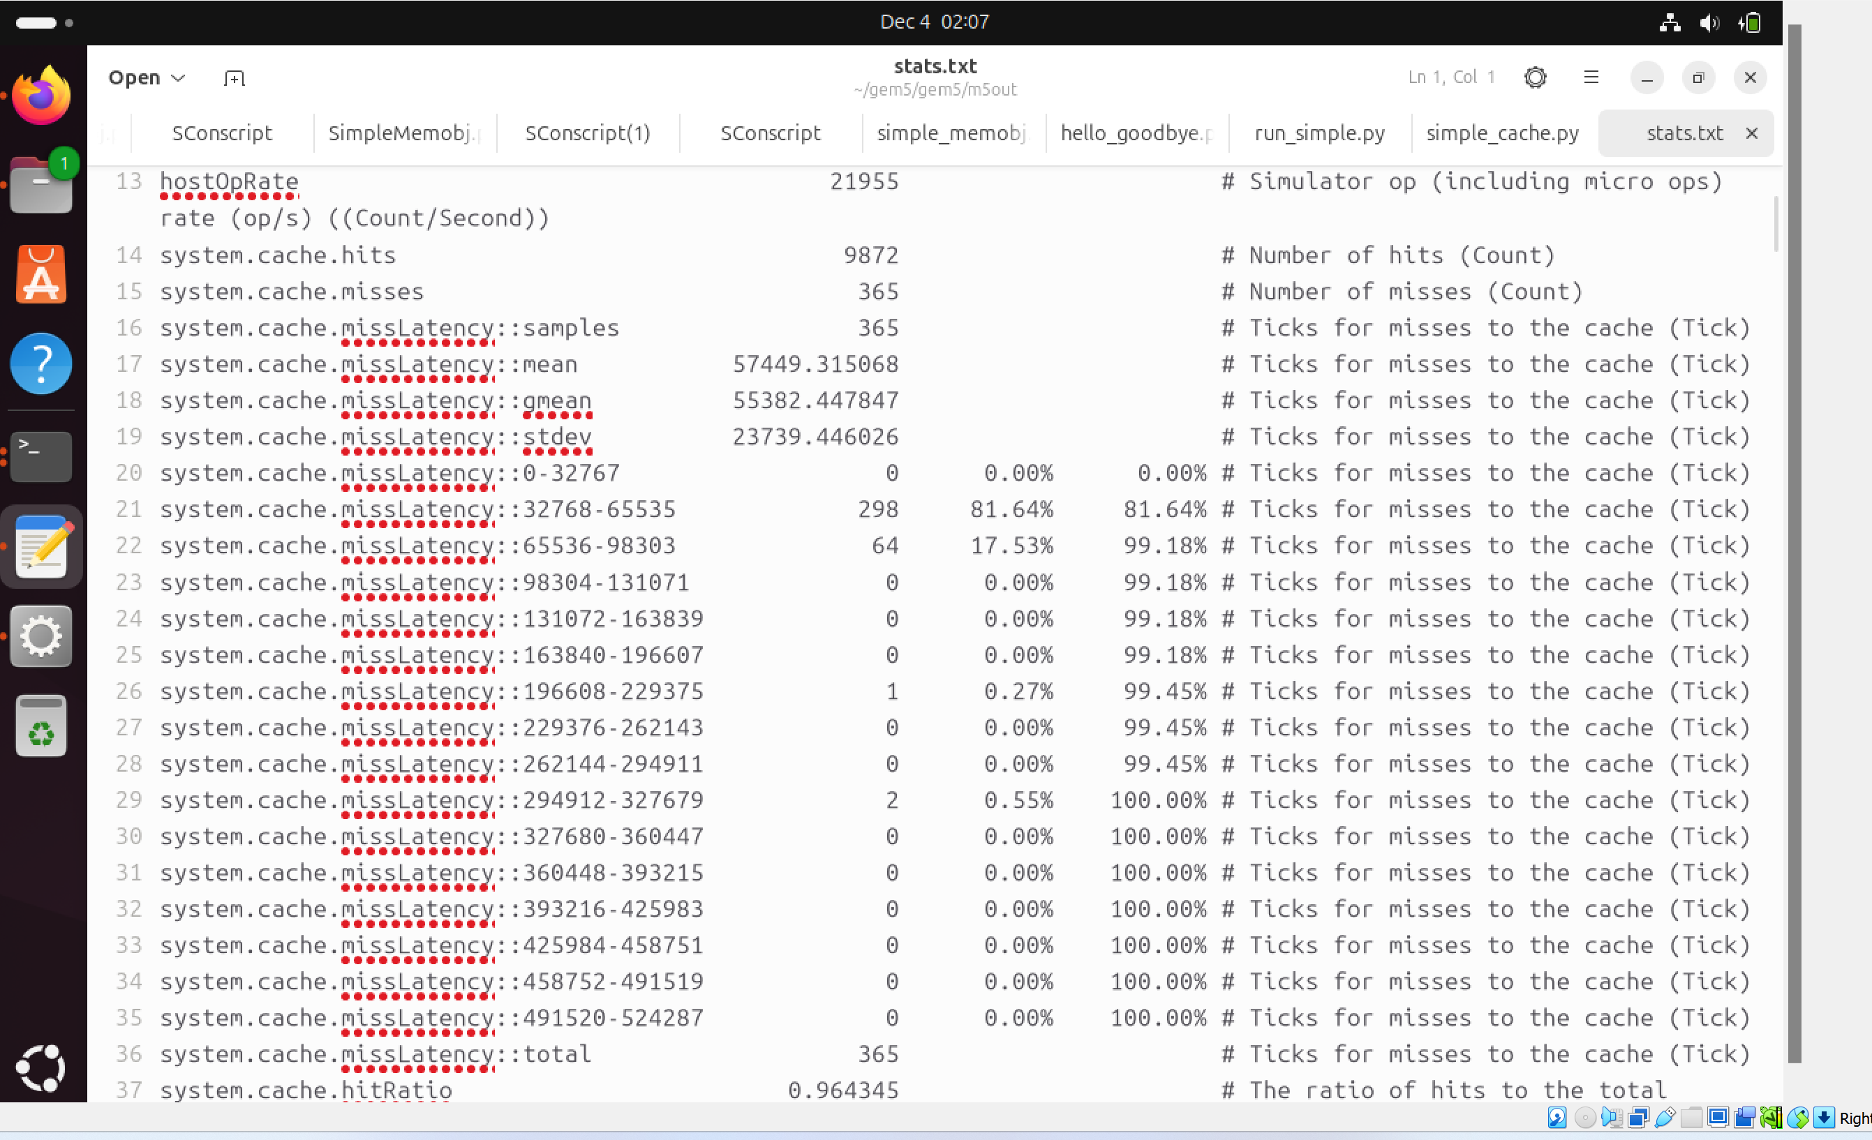
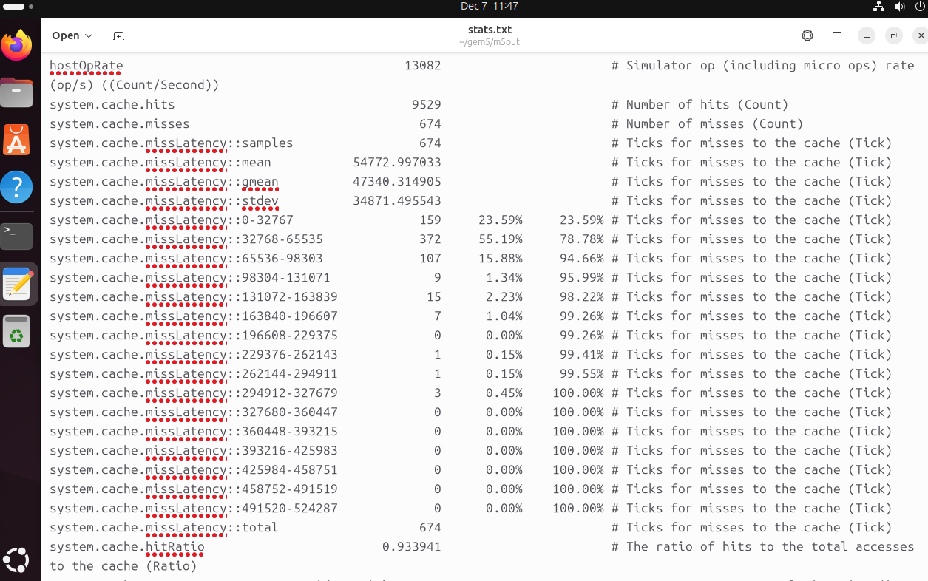
Result and Deliverable cont.
Testing the Cache of 128 KB size
Direct Mapped
2 Way Set Associative
Hit Ratio changes from 0.964345 to 0.933941

Slide 10
Result and deliverable cont.
Learned about implementing different data structure into the cache system.
Instead of using original unordered map, we had to utilize a 2 dimensional vector (vector of vectors) to allow for multiple sets.
Allows us to test hit/miss rates not only based on size, but also size and association type.
DebugInfo displayed based on debugInfo bool being True.

Slide 11
Summary
Completed tutorials on SimObjects, parameters, and events.
Added features like invocation counting and custom debug outputs.
Explored cache associativity with performance analysis.
Addressed TA feedback with meaningful enhancements.
Delivered practical tools for real-world gem5 simulations.

